Slide 1

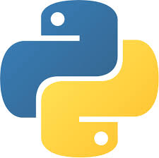
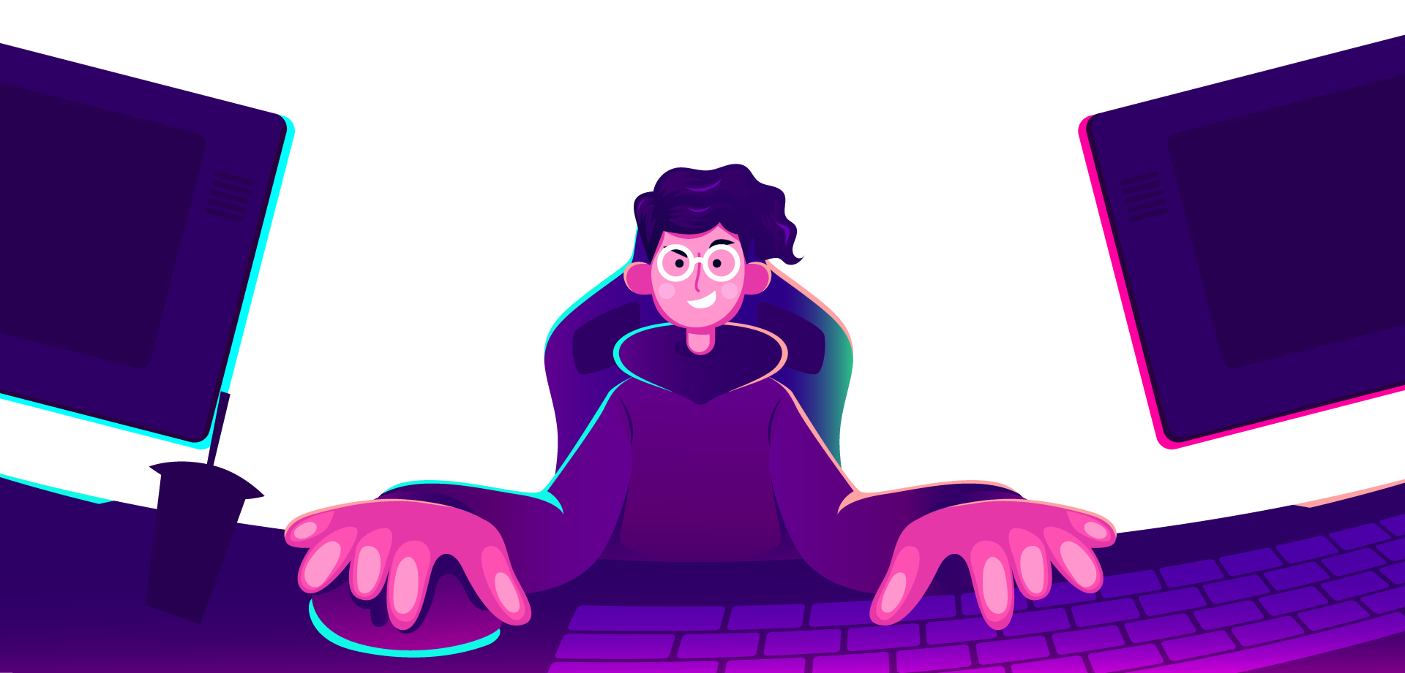
AI Master Class series – Day 8
Emotion Recognition using OpenCV

Slide 2
Day-8 Agenda.
01.
02.
03.
Face emotion recognition
Overview on Libraries used
Face emotion recognition
Face emotion recognition & its application
Face recognition library
Real-time face emotion recognition

Slide 3
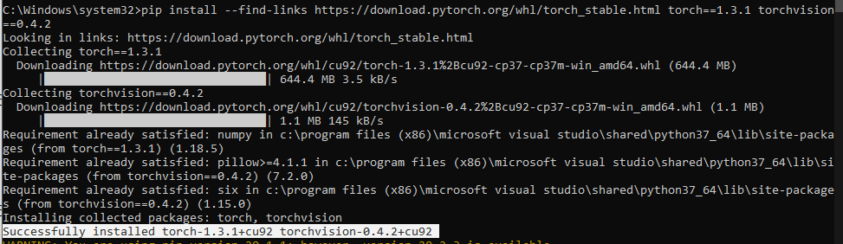
Installing Libraries
pytorch: pip3 install --find-links https://download.pytorch.org/whl/torch_stable.html torch==1.3.1 torchvision==0.4.2

Slide 4
Installing Libraries
Facial Emotion recognition: pip install facial-emotion-recognition

Slide 5
Configuring Torch for CPU
./site-package/torch/serialization.py
Change:
def load(f, map_location=None, pickle_module=pickle, **pickle_load_args):
to
def load(f, map_location='cpu', pickle_module=pickle, **pickle_load_args):

Slide 6
Face emotion recognition.
Facial emotion recognition is the process of detecting human emotions from facial expressions. The human brain recognizes emotions automatically, and software has now been developed that can recognize emotions
AI can detect emotions by learning what each facial expression means and applying that knowledge to the new information presented to it. Emotional artificial intelligence, or emotion AI, is a technology that is capable of reading, imitating, interpreting, and responding to human facial expressions and emotions.

Slide 7

Practical session

Slide 8
Face Emotion Recognition

Slide 9
from facial_emotion_recognition import EmotionRecognition
import cv2
emRec = EmotionRecognition(device='cpu')
cam = cv2.VideoCapture(0)
while True:
success, frame = cam.read()
frame = emRec.recognise_emotion(frame, return_type='BGR')
cv.imshow('frame', frame)
key = cv2.waitKey(1)
if key == 27:
break
cam.release()
cv2.destroyAllWindows()

Slide 10
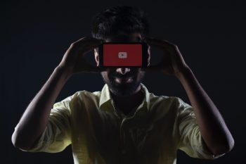
AI News – Day 8. Sept - 2020
Google is returning to using humans for YouTube moderation after repeated errors with its AI system.
Moderating a large network like YouTube is no easy task. Aside from the sheer volume of content uploaded every day, moderators are subjected to the worst of humanity and often end up

Slide 11
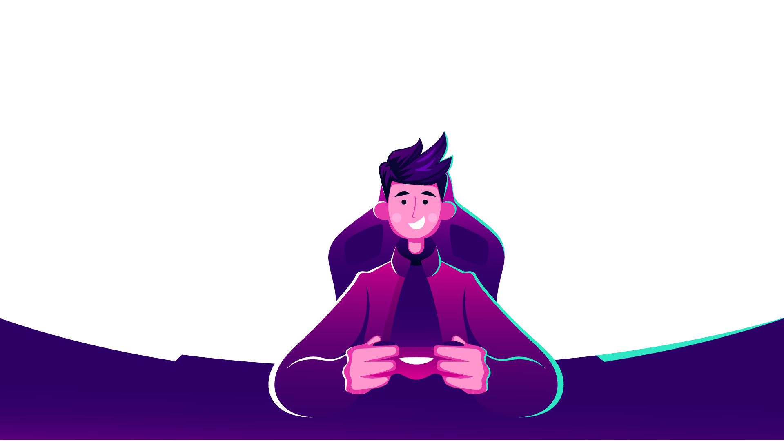
Thanks!
Tomorrow session
Do you have any questions?
sanjay@pantechmail.com
www.pantechsolutions.net
Introduction to Deep Learning | How to install DL Libraries

